Slide 1
Developing services with Azure Functions 2.0
Kamil Mrzygłód, Jakub Gutkowski | AzureDay 2019, Poland

Slide 2
Agenda
Introduction
V1 and V2 differences
Developing Azure Functions
Deploying
Debugging
Custom bindings and triggers
Azure Event Grid and Azure Logic Apps integration

Slide 3
Introduction
Who are we?

Slide 4
Who are we?
Kamil Mrzygłód
Jakub Gutkowski
Senior Software Developer @ Demant Technology Centre
Trainer, consultant and book author
Microsoft Azure MVP
Dodaj coś od siebie ☺

Slide 5
V1 and V2 differences
What has changed recently?

Slide 6
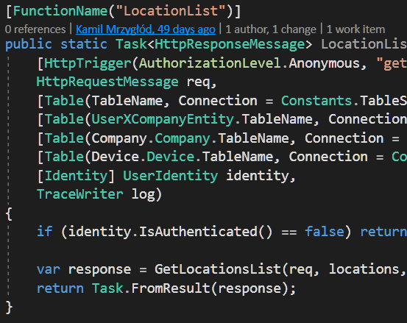
Azure Functions V1
.NET Framework
Based on Azure WebJobs
Quickly become really popular
FaaS offer for Azure
Dependencies hell
Sloppy [HttpTrigger]
Extensible
C#, F#, NodeJS support(other languages like Python or Typescript in the experimental phase)

Slide 7
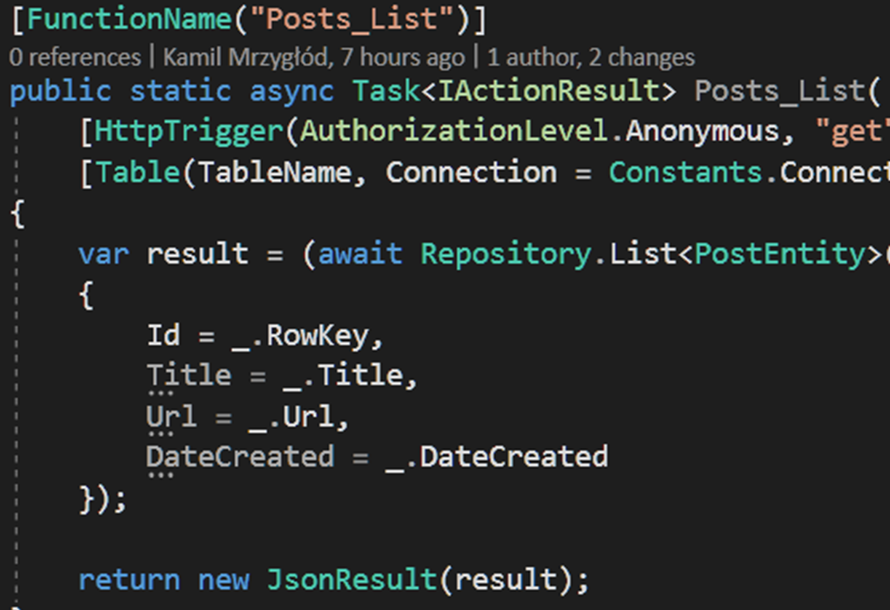
Azure Functions V2
.NET Core
Based on Azure Functions V1
Extensions model changed
Only one language per Function App
Java support
Dropped experimental support for languages like PHP, Powershell or Bash

Slide 8
V1 and V2 comparison
Azure Functions V1
Azure Functions V2
NET Framework
Multiple languages supported in a single Function App
Many core extensions(mainly Azure Storage) already packaged inside the runtime
Lacking performance
Obscure extensions model
Cannot run on Linux/macOS
.NET Core
Dropped support for multiple languages
Need to install each required extension
Improved performance
Improved extensions API
Runs on Windows/Linux/macOS

Slide 9
Developing Azure Functions
Toolset, CLI, basic concepts

Slide 10
Toolset
Visual Studio or Visual Studio Code
Azure Functions CLI
Storage Emulator
Microsoft Azure Storage Explorer

Slide 11
Getting started
To initialize a new Functions project, run func init and select the runtime you are interested in

Slide 12
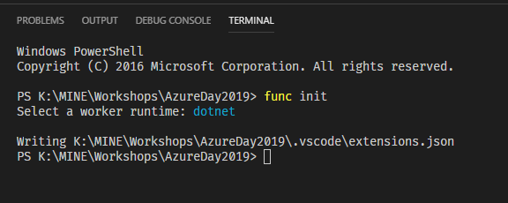

Slide 13
Creating a function
To create a function, run the func function new command and select the trigger you are interested in

Slide 14
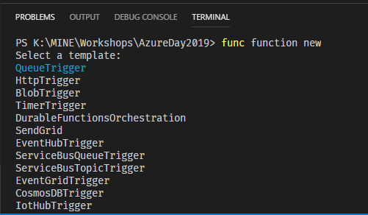

Slide 15
Starting the host
To start the host, run the func host start command

Slide 16
Triggers and bindings
Trigger
Binding
A function can have only one trigger
Makes your function execute
Function App can have multiple different triggers
Most of the native triggers require Azure Storage to work correctly
Integrates your function with external dependencies(like storage, bus or APIs)
A function can have multiple different(or the same) bindings
Evaluated before function execution(though runtime binding is also possible)

Slide 17
Exercises
Initialize a new Function App in NodeJS and add a new HttpTrigger to it
Initialize a new Function App and:
Add a function triggered by Blob
Add a function triggered by Timer
Set a timer to trigger a function each 1 minute
Add a function triggered by HTTP and ensure, that it can be called only via POST calls

Slide 18
Deploying
Deploy your functions to Azure

Slide 19
Deploying to Azure
To deploy your Function App to Azure, run the func azure functionapp publish command

Slide 20
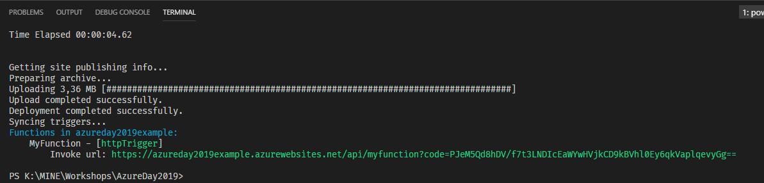

Slide 21
Exercises
Add a new function to your Function App and deploy it once again
Create new Function App with an HTTP trigger and deploy it using –nozip switch, compare both applications
Deploy a Function App(.NET) without building it. Make a local change and retry. Is your change available in Azure?

Slide 22
Debugging
Locally & Remotely

Slide 23
Debugging locally
To debug locally, put a breakpoint where you want the execution to stop and hit F5 button

Slide 24
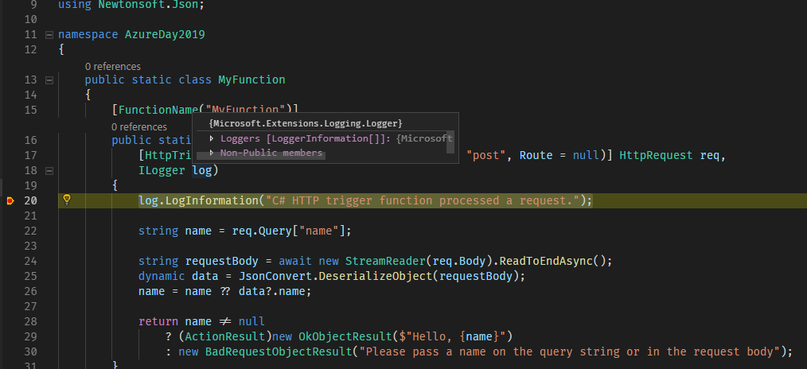

Slide 25
Things to note
The debugging experience in VS and VS Code are very similar
You cannot use func host start to debug your functions
A running host is needed to be able to debug functions

Slide 26
Debugging remotely
To debug remotely, publish your Function App and use Cloud Explorer to attach a debugger

Slide 27
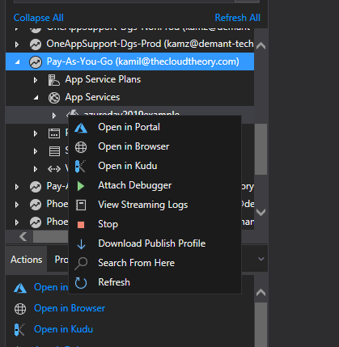

Slide 28
Things to note
Remote debugging is only available in VS
Debugging remotely on production may not be the best way to find bugs ☺

Slide 29
Custom bindings and triggers
Writing your own extensions

Slide 30
Extension API
Bindings
Triggers
IWebJobsStartup
IExtensionConfigProvider
Attribute
IBindingProvider
IBinding
IValueProvider
IWebJobsStartup
IExtensionConfigProvider
Attribute
ITriggerBindingProvider
ITriggerBinding
IValueProvider
IListener
ITriggerData

Slide 31
Binding idea
Automatic retrieving parameters from the query string

Slide 32
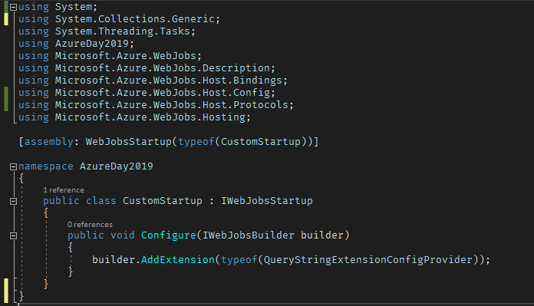
Getting started with IWebJobsStartup

Slide 33
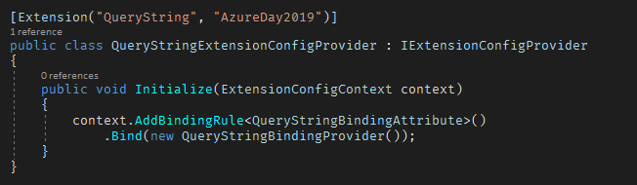
Getting started with IExtensionConfigProvider

Slide 34

Getting started with an attribute

Slide 35
Exercises
Add a new function triggered by HTTP – change its logic to use the custom binding
Change the logic of the binding, so it returns only the first N parameters

Slide 36
Trigger idea
Triggering a function with tweets

Slide 37
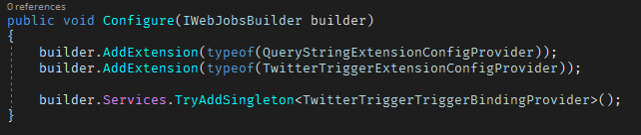
Getting started with IWebJobsStartup

Slide 38
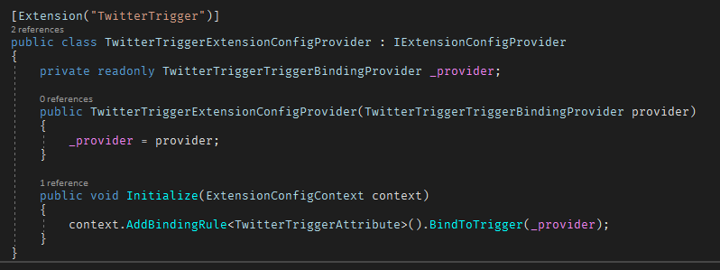
Getting started with IExtensionConfigProvider

Slide 39
Exercises
Implement a function triggered by the TwitterTrigger
Change the logic of the trigger, so a function is triggered by a text passed via parameter
Implement a simple BlobTrigger

